Slide 1
The Latest in Lunar Science Discovery
Clive R. Neal
Department of Civil & Env. Eng. & Earth Sciences,
University of Notre Dame
http://www.nd.edu/~cneal
neal.1@nd.edu

Slide 2
Recent Moon Missions
COUNTRY NAME TYPE YEAR
USA Clementine Orbiter 1994
USA Lunar Prospector Orbiter 1998
Europe SMART-1 Orbiter 2003
Japan Kaguya/Selene Orbiter 2007
China Chang’e-1 Orbiter 2007
India Chandrayaan-1 Orbiter 2008
USA LRO Orbiter 2009
USA LCROSS Impactor 2009
China Chang’e-2 Orbiter 2010
USA ARTEMIS Orbiter 2010
USA GRAIL Orbiter 2011
1959-1976 = 60 Missions to the Moon by the USA and Soviet Union (Flybys, Orbiters, Landers)
Notes:
Animated: 1) Clementine Fe, Ti maps; 2) LP K and Th maps; 3) Use the Clem + LP to get terrane maps.

Slide 3
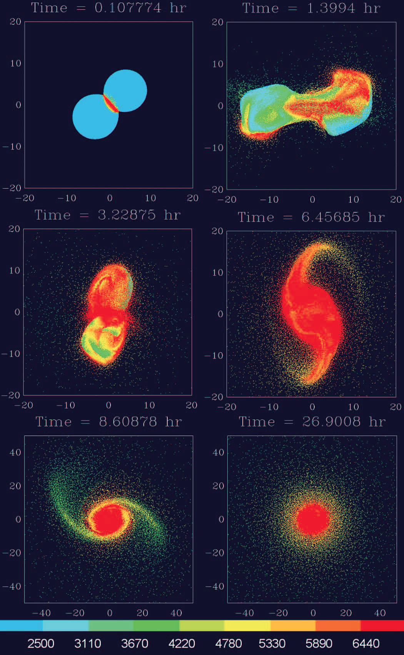
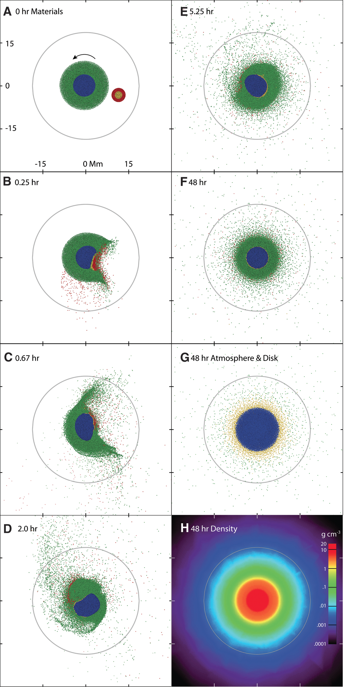
Moon Origin
Canup (2012) Science 338, 1052-1057
Impact into spinning Earth ejects Earth mantle material to form the Moon
Cük & Stewart (2012) Science 338, 1047-1052
Homogenization of ejected material in debris disk explains isotopic similarities
Notes:
Animated: 1) Clementine Fe, Ti maps; 2) LP K and Th maps; 3) Use the Clem + LP to get terrane maps.

Slide 4
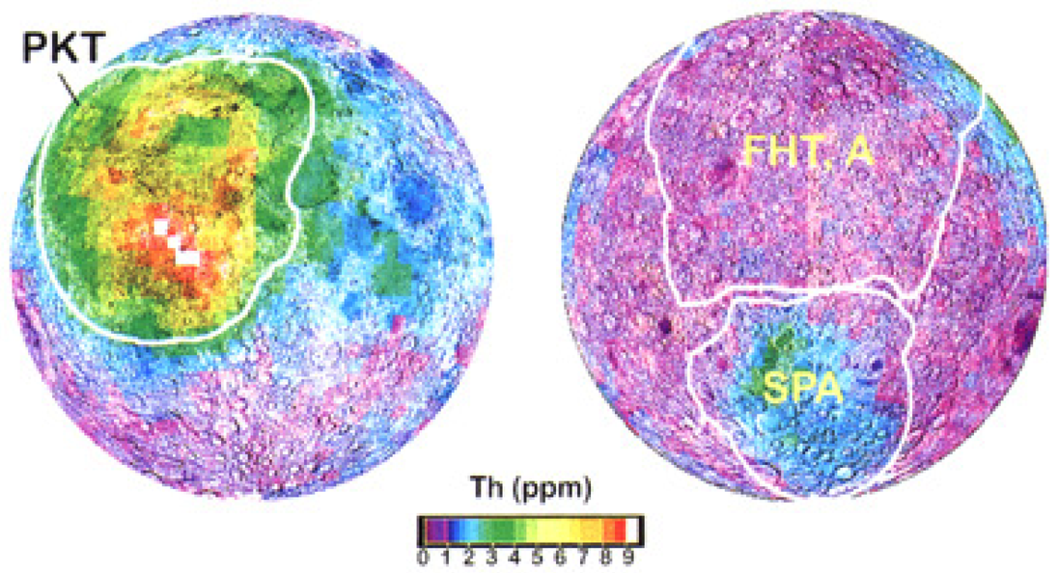
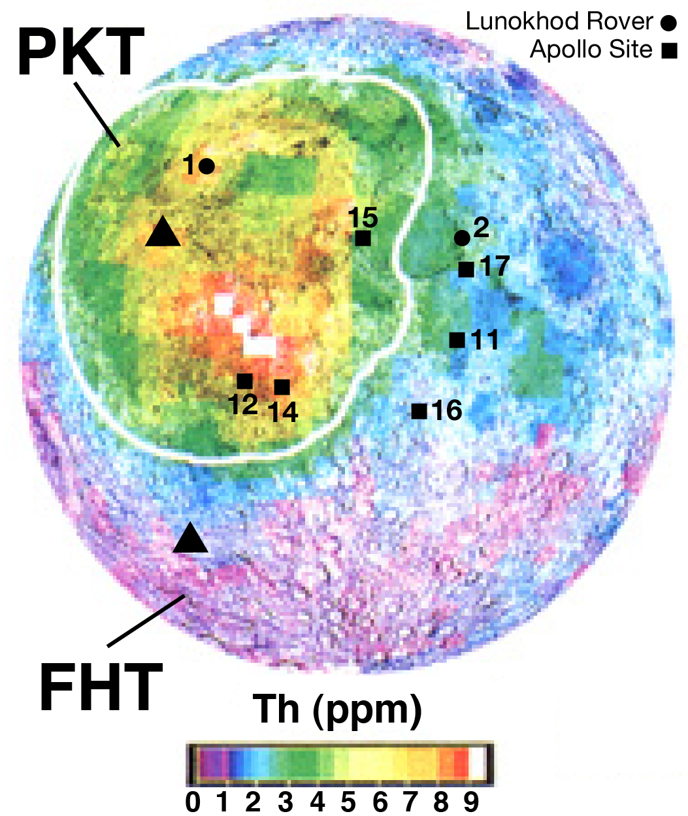
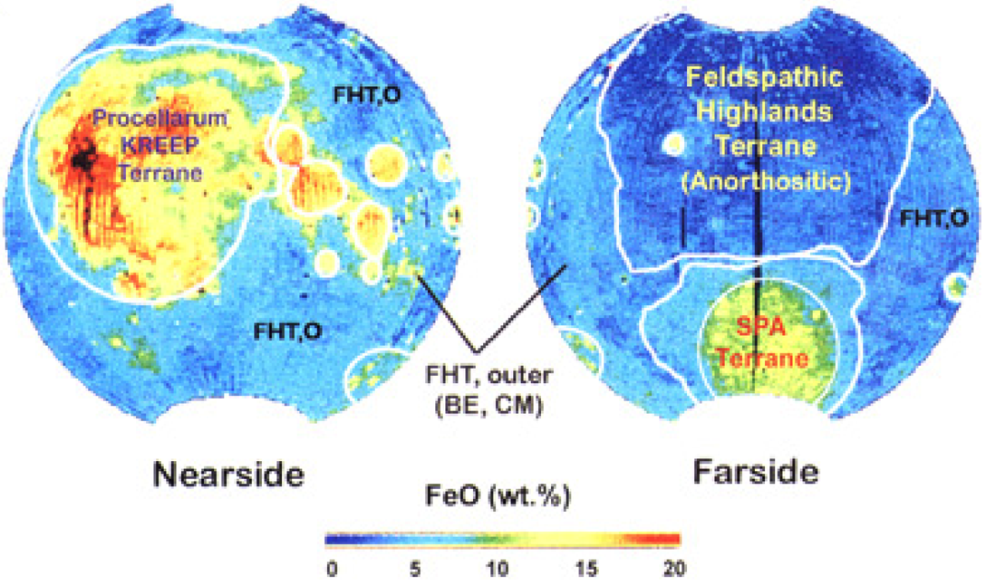
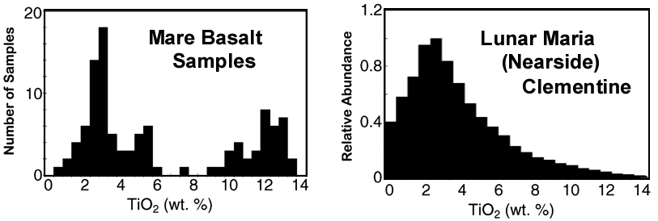
Non-Representivity of Apollo Sites
Lunar Terranes
[Jolliff et al. (2000) JGR 105, 4197]
Apollo sites close to terrane boundaries.
Samples contain PKT signature.
Apollo sample collection is not representative of the lunar compositional diversity.
Giguere et al. (2000) MaPS 35, 193
Notes:
Animated: 1) Clementine Fe, Ti maps; 2) LP K and Th maps; 3) Use the Clem + LP to get terrane maps.

Slide 5
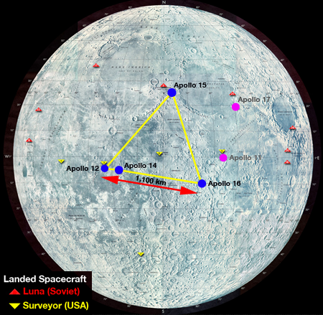
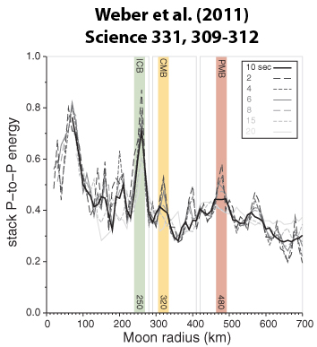
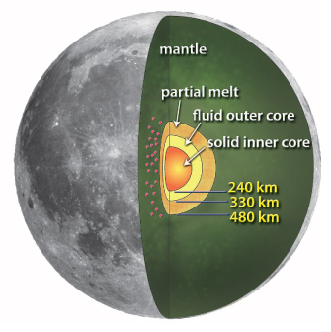
Reinterpretation of the Apollo Seismic Data + GRAIL Data
Thinning of the nearside crust!
Toksoz et al. (1972) Sci. 176 60-65 km
Khan & Mosegaard (2002) JGR 107 45 km
Lognonné et al. (2003) EPSL 211 30 km
Chenet et al. (2006) EPSL 243 31-38 km
Wieczorek et al. (2013) Sci. 339 34-43 km
Detection of the Lunar Core?
Garcia et al. (2011) Planetary & Space Science 188, 96-113.
Weber et al. (2011) Science 331, 309-312
Notes:
Apollo Passive Seismic experiment. Point out locations and small footprint.

Slide 6
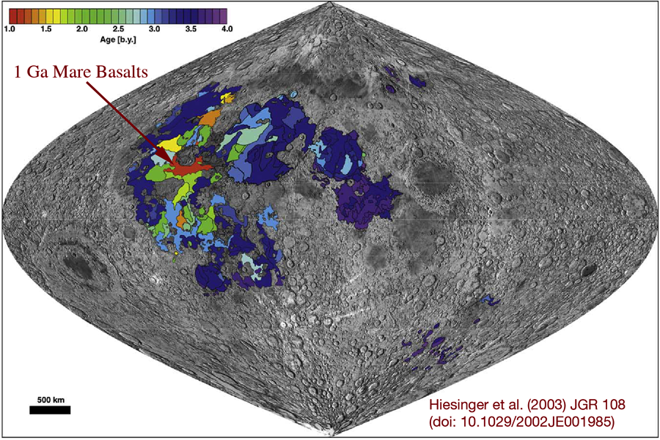
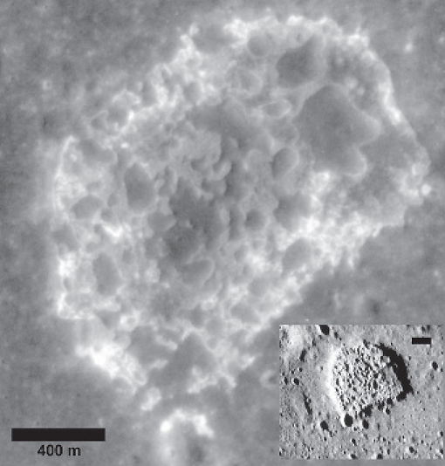
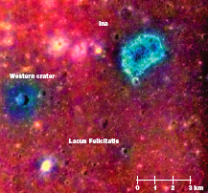
Recent Volcanic Activity
“Recent” volcanic eruptions ~ 1 Ga.
Hiesinger et al. (2003) JGR 108, doi:10.1029/2002JE001985;
Hiesinger et al. (2010) JGR 115, doi:10.1029/2009JE003380
Recent fumarolic eruptions; ~10 Ma?
Ina depression in Lacus Felicitatis
Schultz et al. (2006) Nature, v. 444, p. 184-186.
Notes:
Apollo Passive Seismic experiment. Point out locations and small footprint.

Slide 7
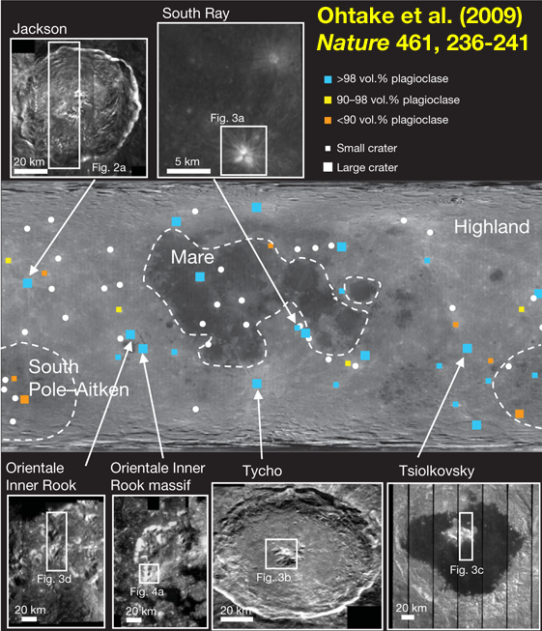
New Lunar Lithologies
New Rock Types not represented in the sample collection.
Pure Anorthosite: Kaguya (SELENE)
Notes:
Could find a graphic for Chandrayaan/M3 “new” rock types. Emphasize that these aren’t represented in the sample collection.

Slide 8
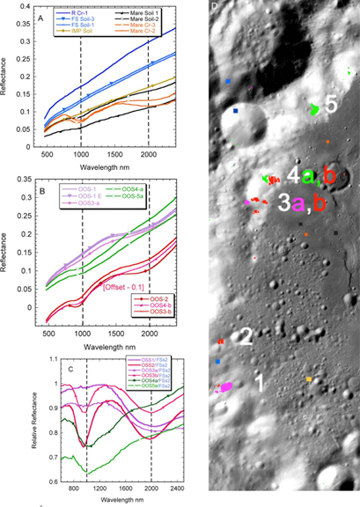
New Lunar Lithologies
New Rock Types not represented in the sample collection.
Olivine, Orthopyroxene, and Mg-Spinel-rich lithologies (OOS)
Chandrayaan-: M3
Pieters et al. (2011) JGR, 116, E00G08
Notes:
Could find a graphic for Chandrayaan/M3 “new” rock types. Emphasize that these aren’t represented in the sample collection.

Slide 9
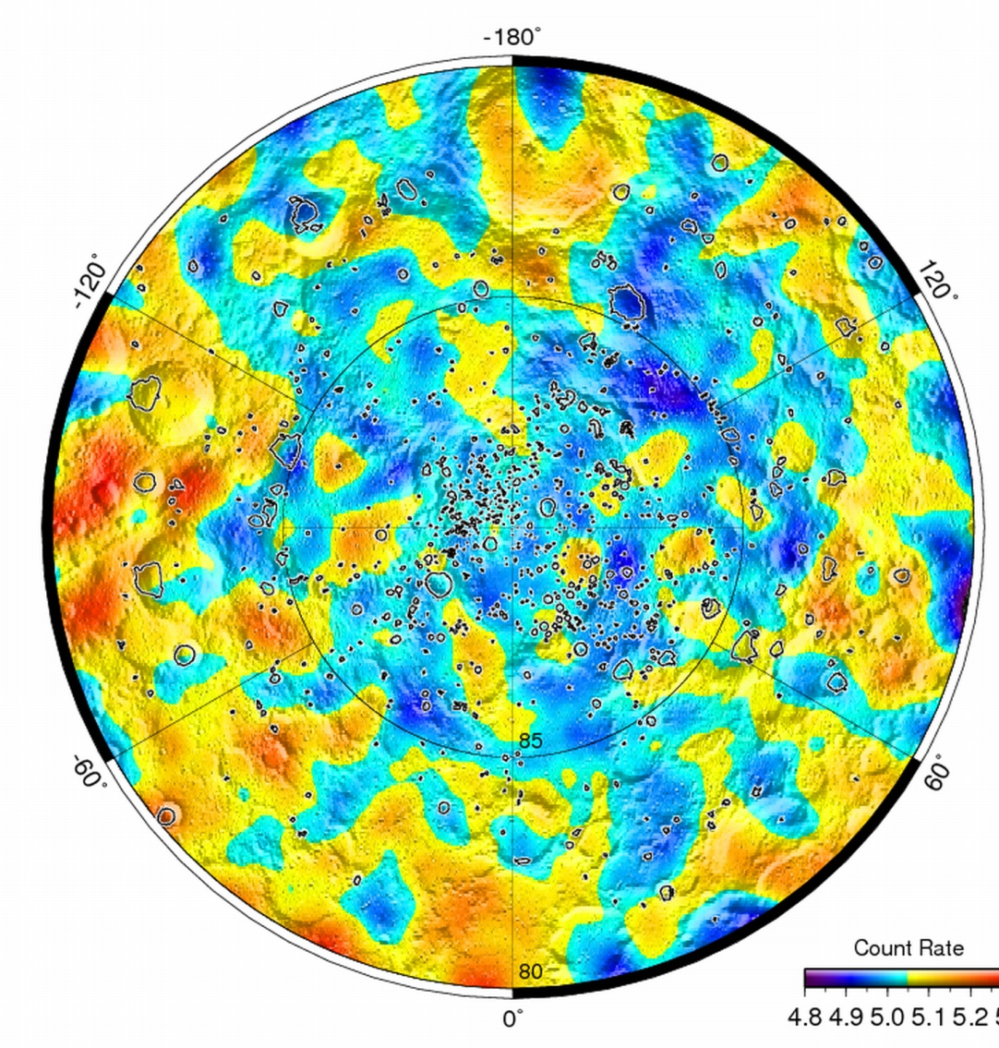
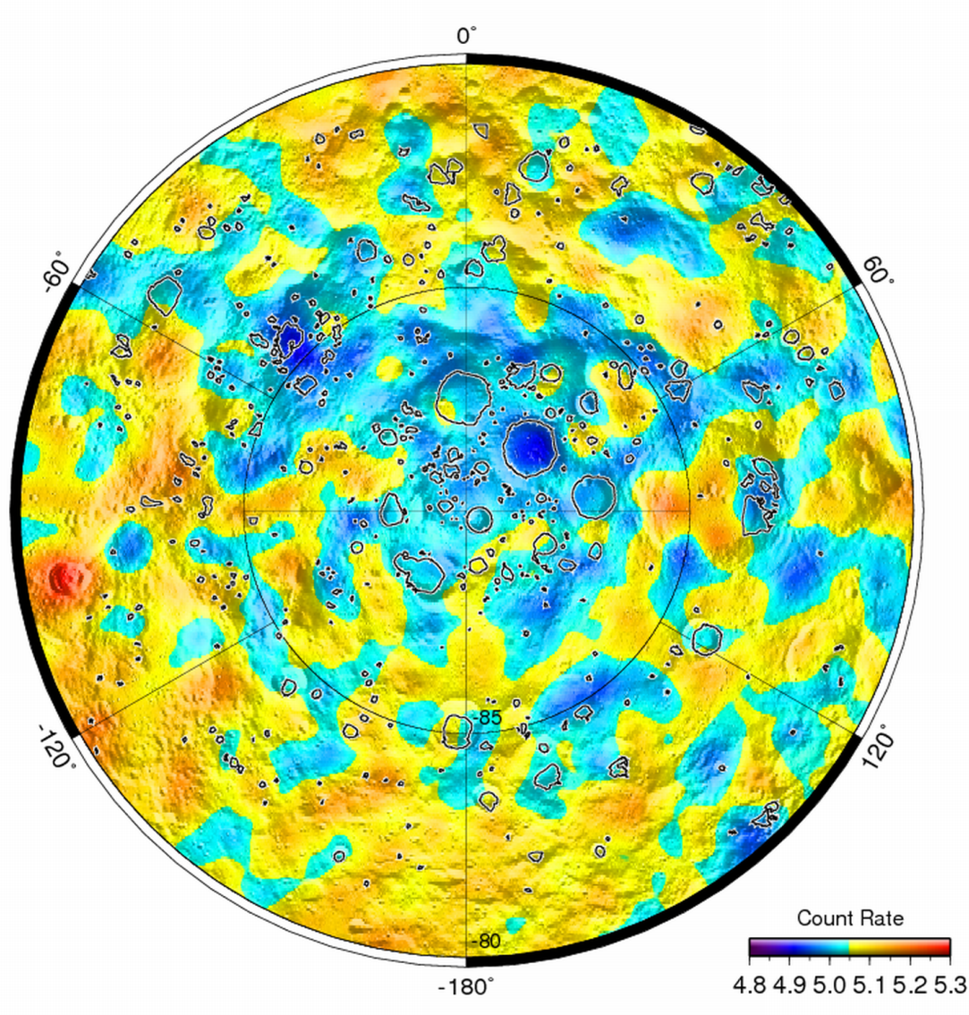
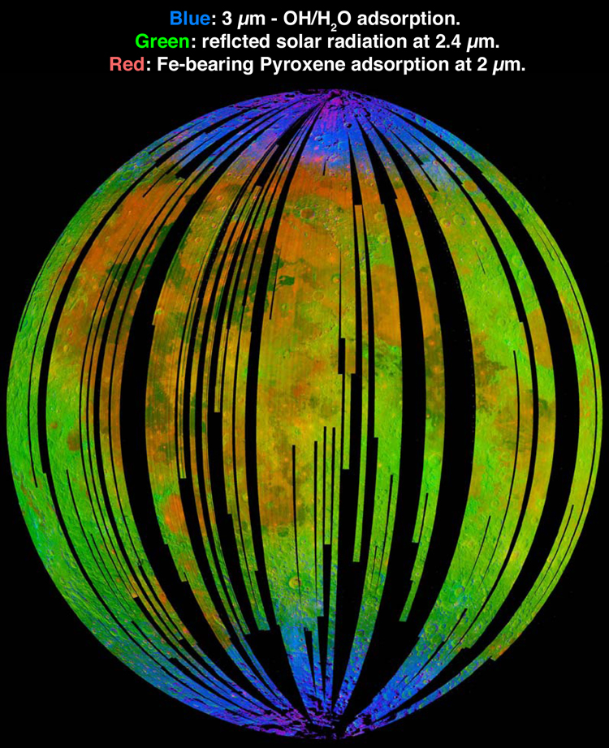
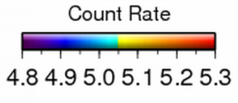
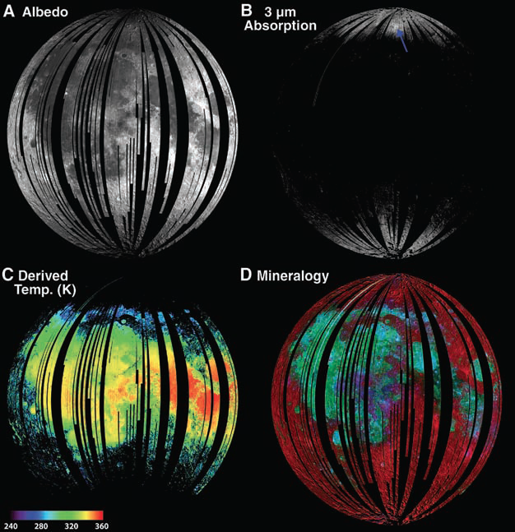
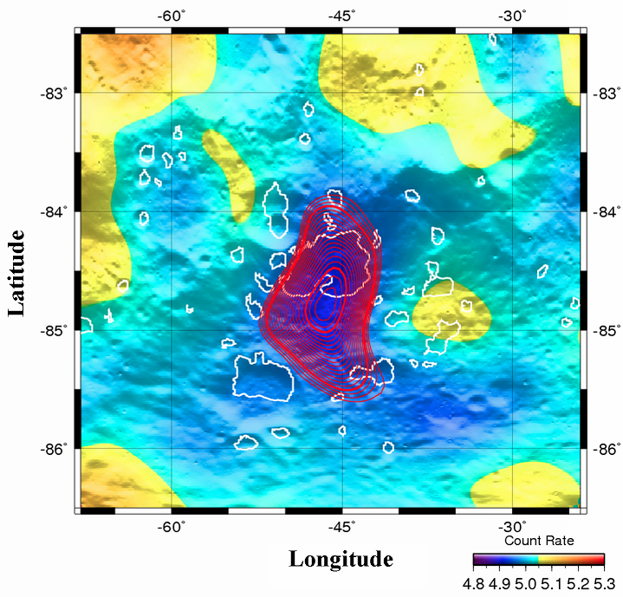
Surface Volatiles on the Moon
Volatile Deposits: Chandrayaan-1 (M3), LRO
Pieters et al. (2009) Science 326, 568-572
Hydrogen Deposits: LRO
Mitrofanov et al. (2010) Science 330, 483-486
Cabeus Crater
OH/H₂O 3µm adsorption
Notes:
Polar volatiles in PSRs emphasized by Clementine and LP; LCROSS confirmed this. M3 suggests that OH/H2O adsorption can occur outside PSRs (as does LEND on LRO).

Slide 10
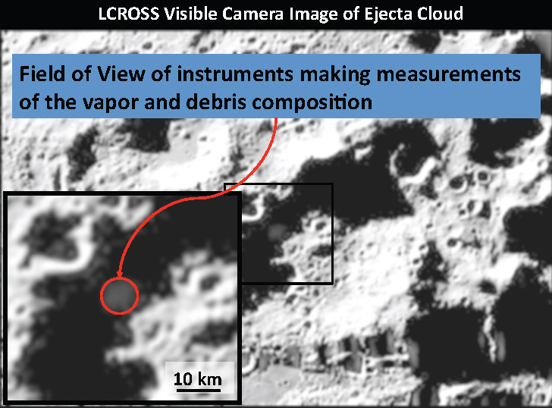
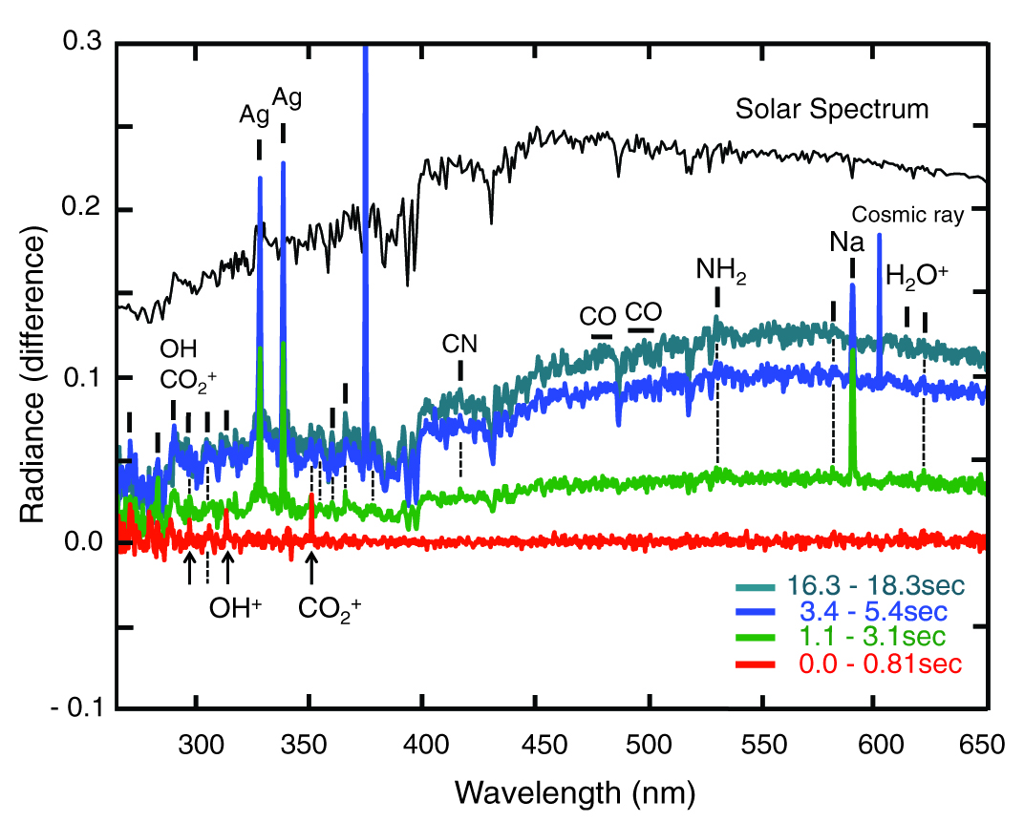
Surface Volatiles on the Moon
LCROSS Impact into Cabeus Crater
Colaprete et al. (2010) Science 330, 463-468.
Schultz et al. (2010) Science 330, 468-472.

Slide 11
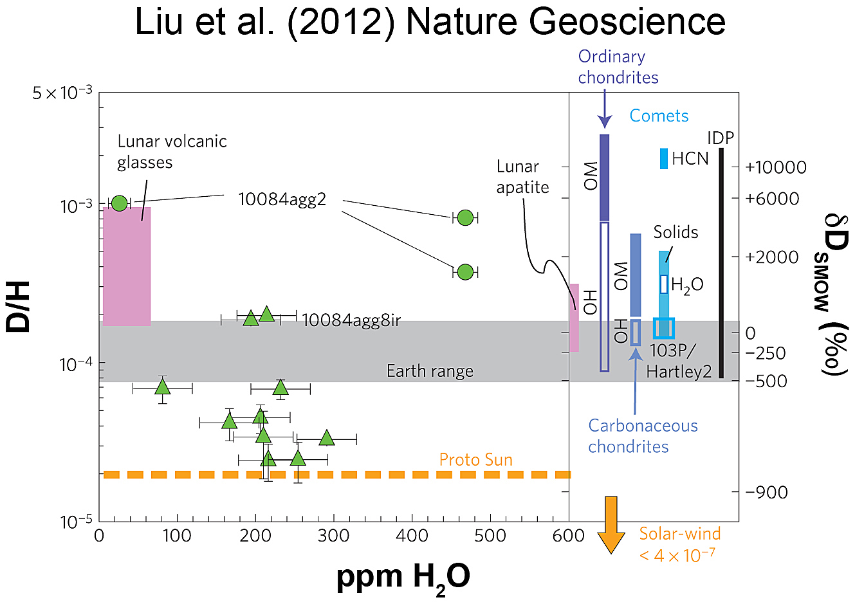
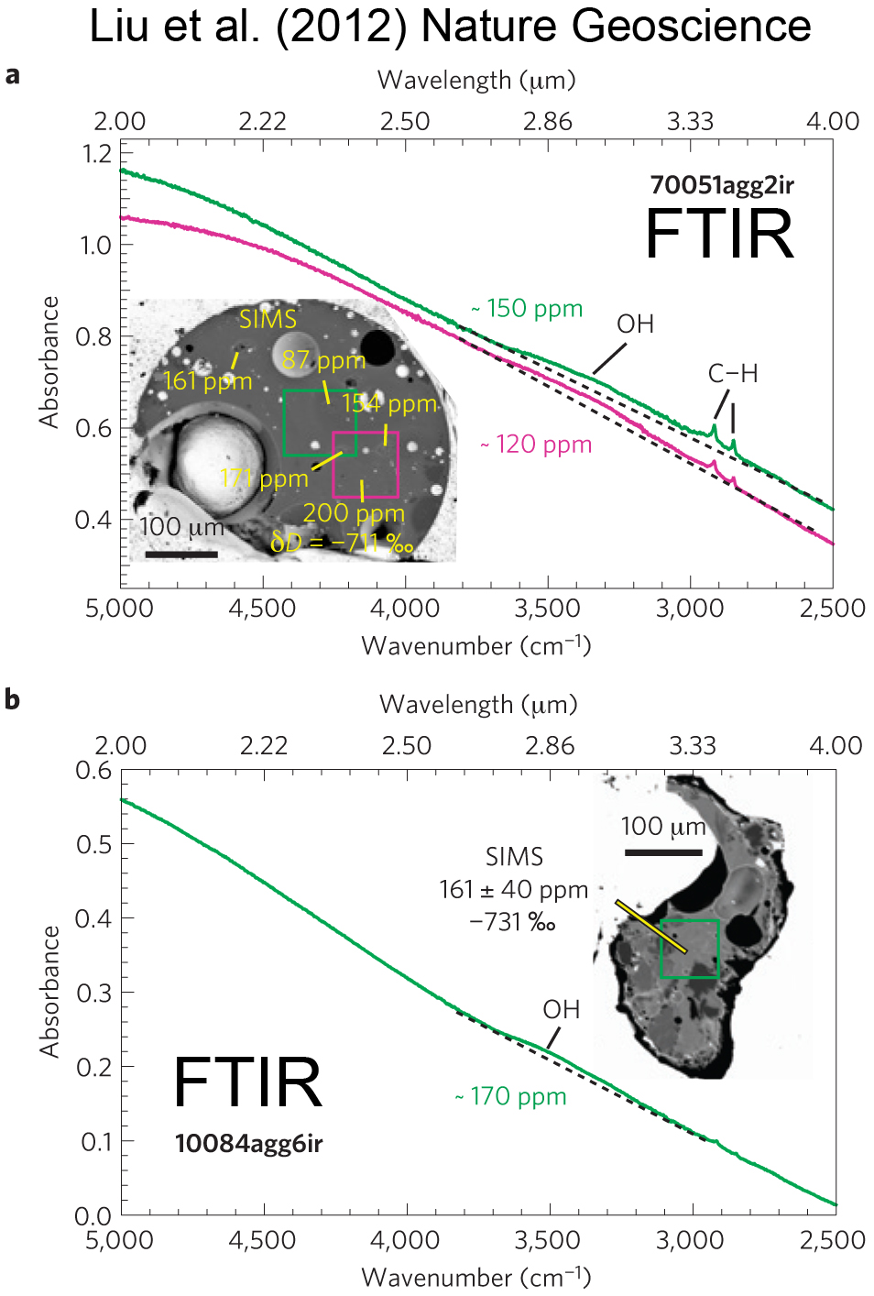
Surface Volatiles on the Moon
OH derived from Solar Wind implanted H
Liu et al. (2012) Nature Geoscience 5, 779-782.

Slide 12
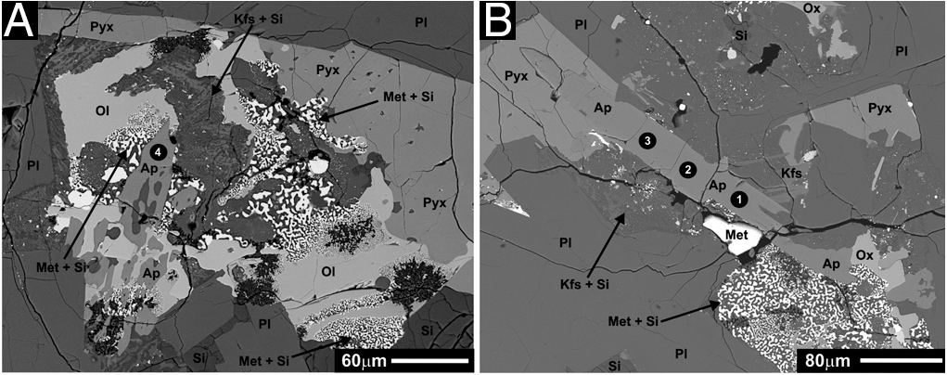
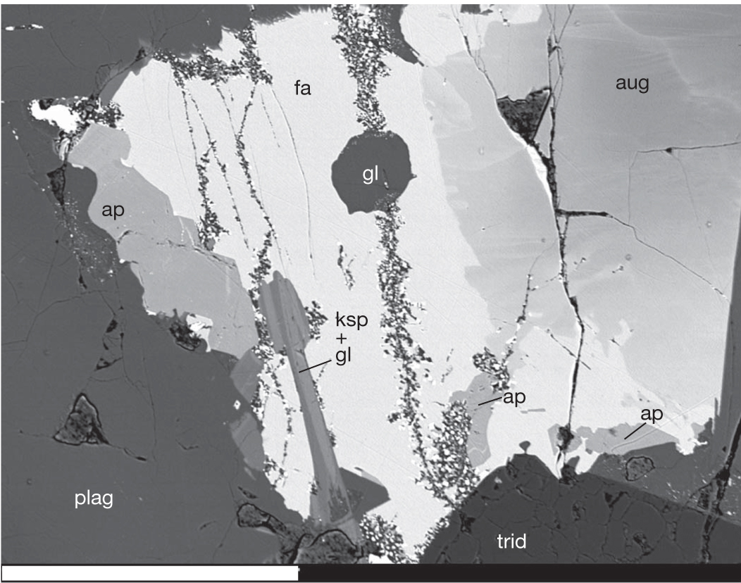
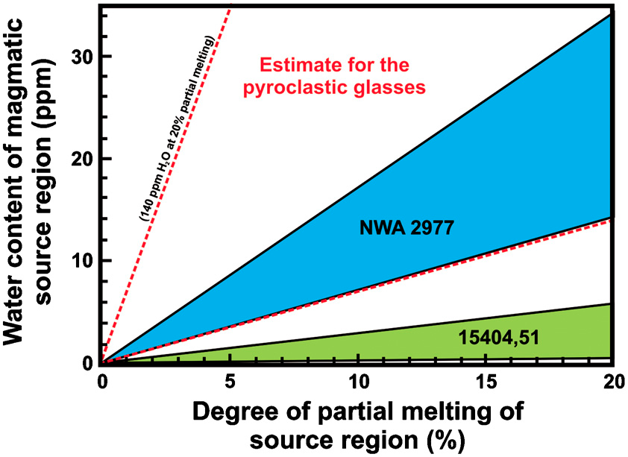
Lunar Endogenous Volatiles
OH content of phosphates
McCubbin et al. (2010) Proc. Nat. Acad. Sci. 107,
11223-11228.
Water in Mare Basalt Sources: 2-5 ppm
14053,16
Liu et al. (2010) LPSC 41, Abs. 2647
Boyce et al. (2010) Nature 466, 466-469
14053,241

Slide 13
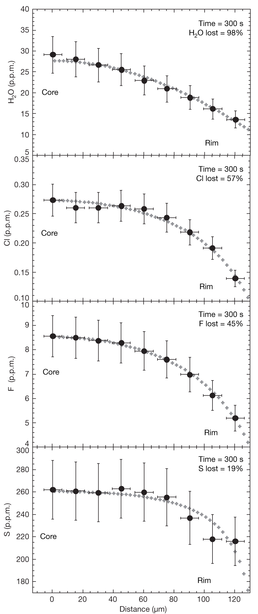
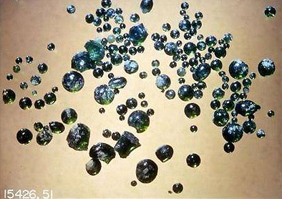
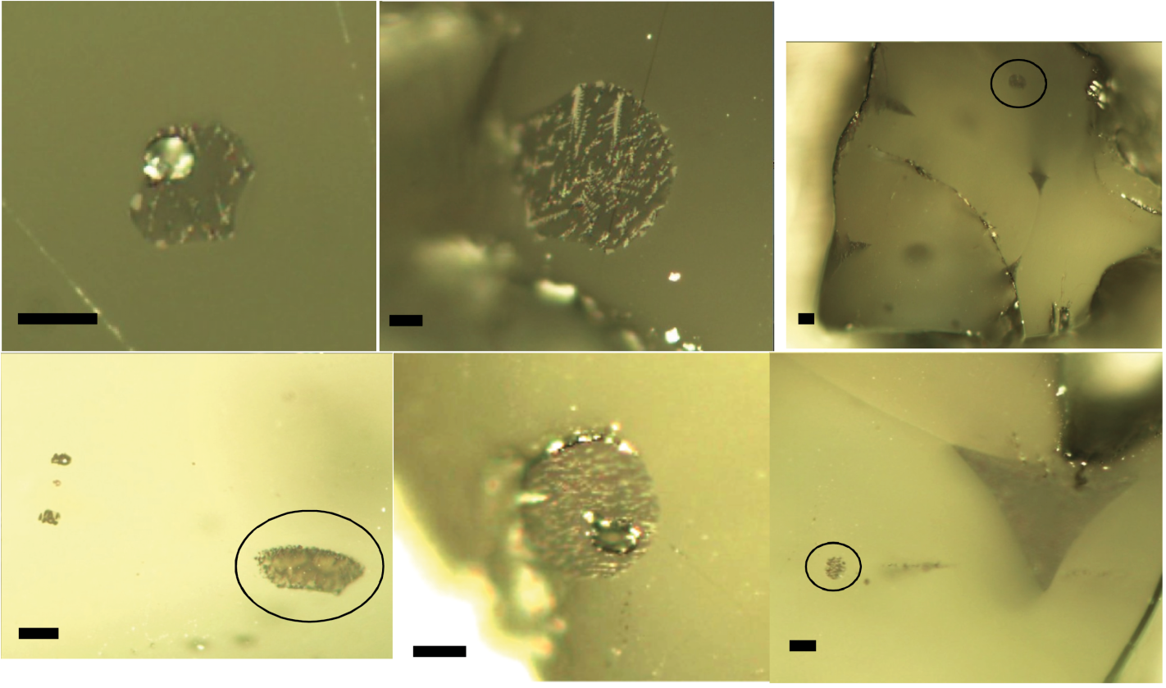
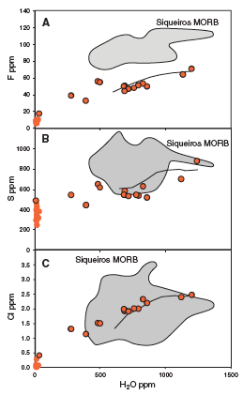
Lunar Endogenous Volatiles
Saal et al. (2008
Nature 454, 192-195)
Water in the Glass Parent Magma: 260-745 ppm
H₂O
Apollo 15 Green Glass (VLT)
Cl
F
Hauri et al. (2011)
Science 333, 213-215
S
Melt Inclusions in Olivine

Slide 14
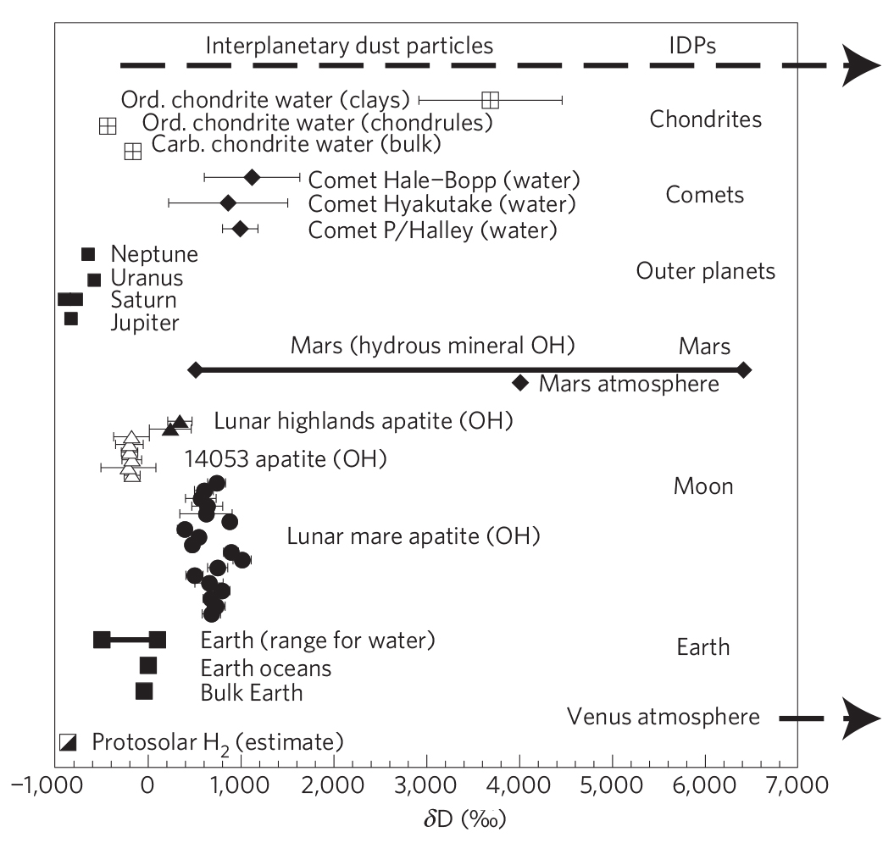
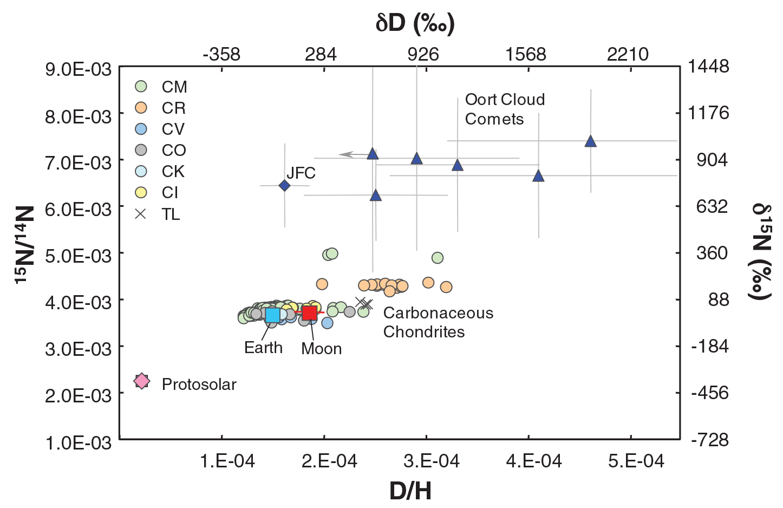
Origin of Lunar Volatiles
Lunar water has a Carbonaceous Chondrite Heritage
Cometary Delivery of Water to the Moon
Saal et al. (2011) Science 340, 1317-1320.
Greenwood et al. (2011) Nature Geosci. 4, 79-82

Slide 15
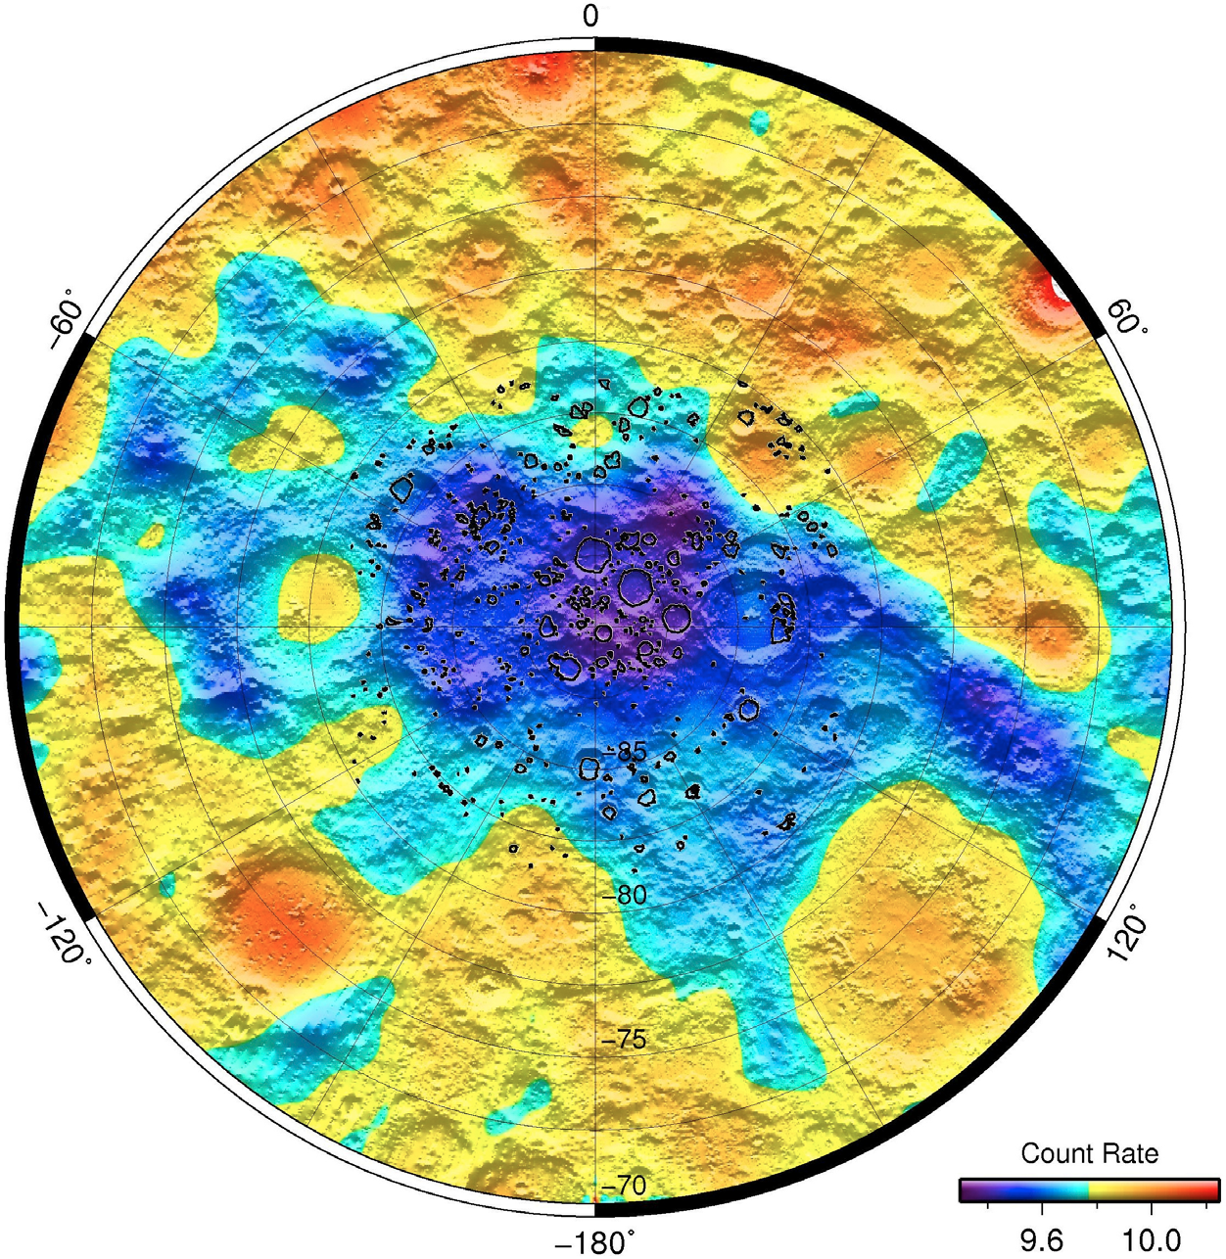
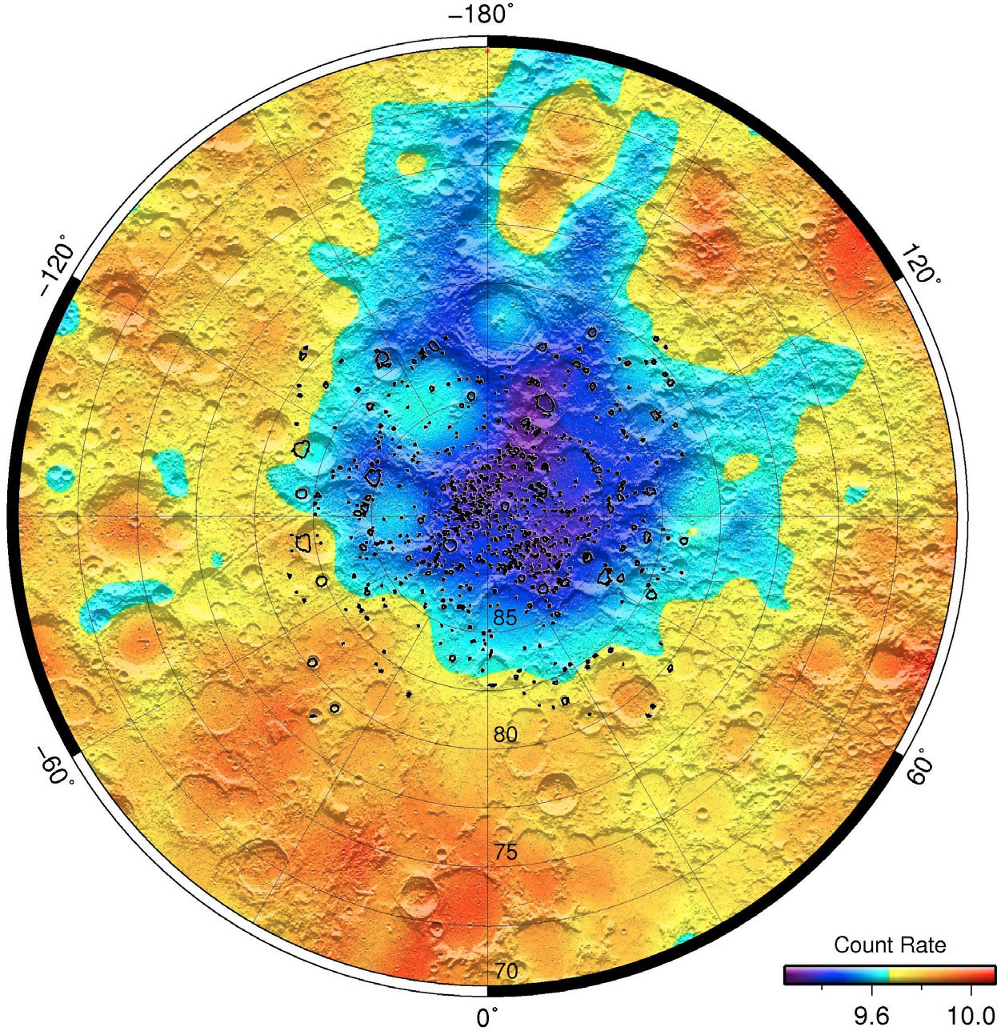
Polar Volatiles
H-rich areas also outside PSRs from LEND neutron maps: don’t need to enter PSRs to extract resources
South Pole
North Pole
Litvak et al. (2012) JGR 117, E00H22, doi:10.1029/2011JE003949

Slide 16
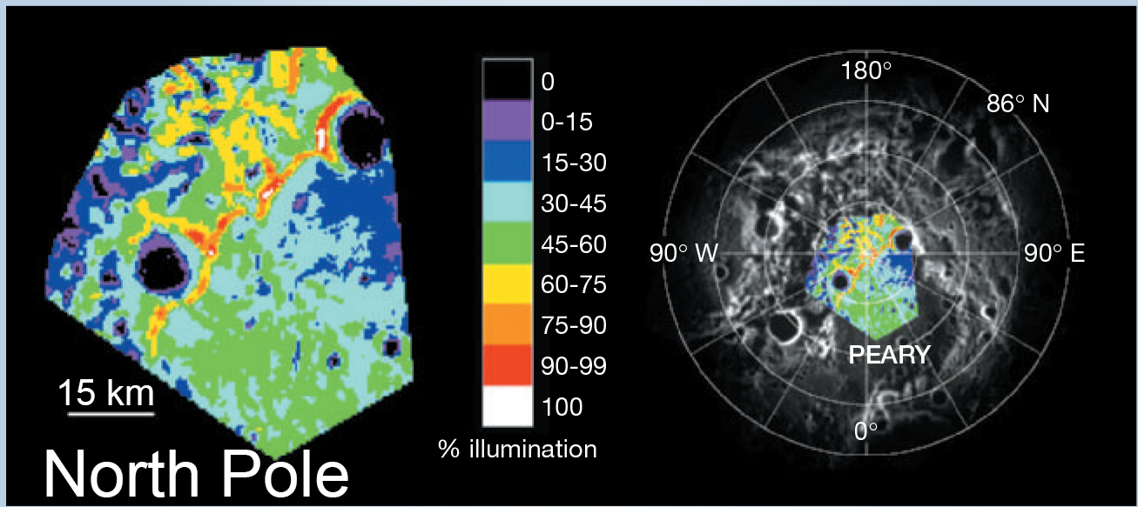
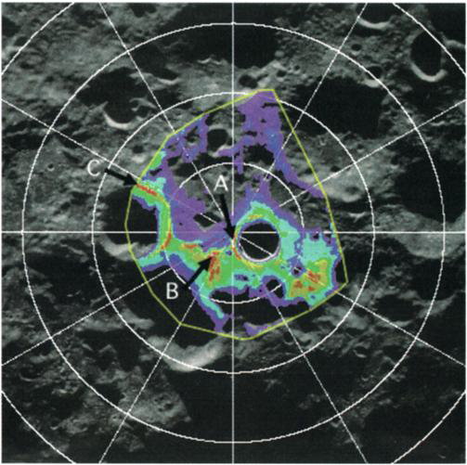
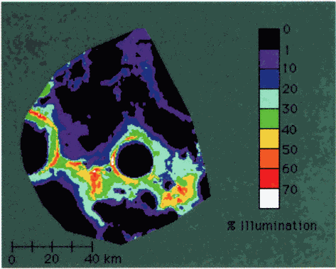
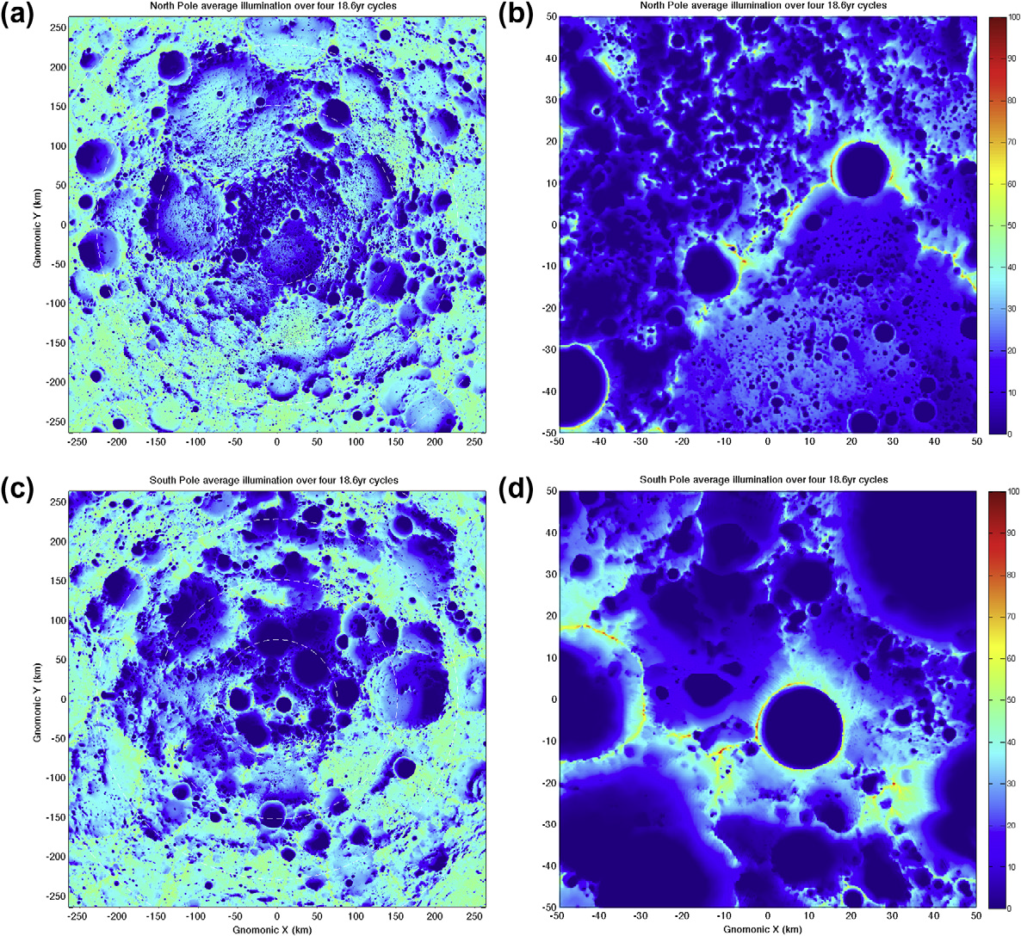
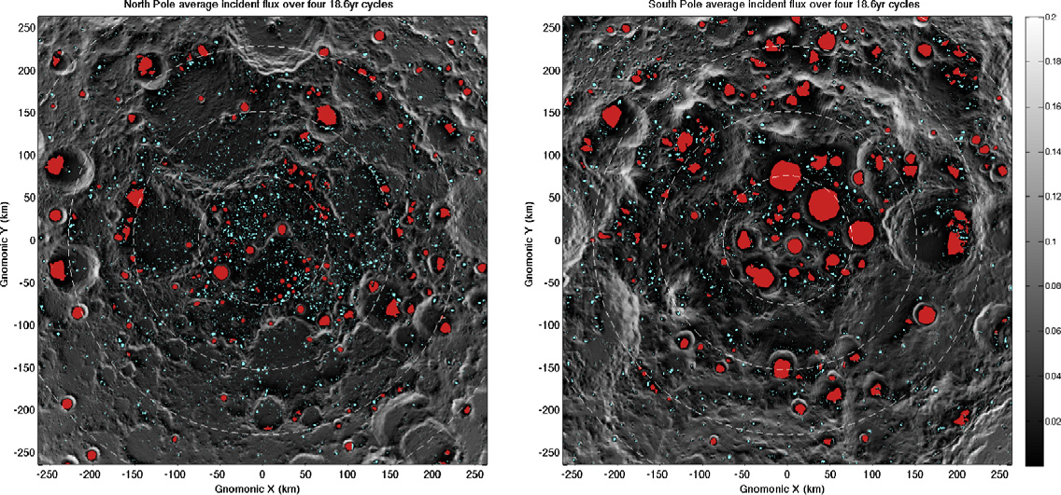
Lunar Polar Illumination Maps
South Pole
Bussey et al. (1999) GRL 26, 1187-1190.
Bussey et al. (2003) GRL 30,
doi:10.1029/2002GL016180.
Bussey et al. (2005) Nature 434, 842.
Mazarico et al. (2011) Icarus 211, 1066-1081.
Illumination (%)
North Pole South Pole
Permanent Shadow
North Pole South Pole

Slide 17
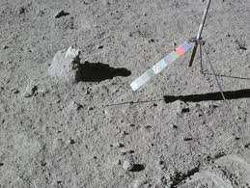
LMO/Moon Volatiles
Water
Elkins-Tanton & Grove (2011, EPSL 307, 173-179): LMO contained 100-1000 ppm H₂O (or more) to form mare source regions.
Hui et al. (2013, Nat. Geosci. 6, 177-180): Ferroan Anorthosite (15415; 60015) plagioclase contain up to 6 ppm H₂O.
Initial LMO ~320 ppm H₂O.
urKREEP ~1.4 wt% H₂O.

Slide 18
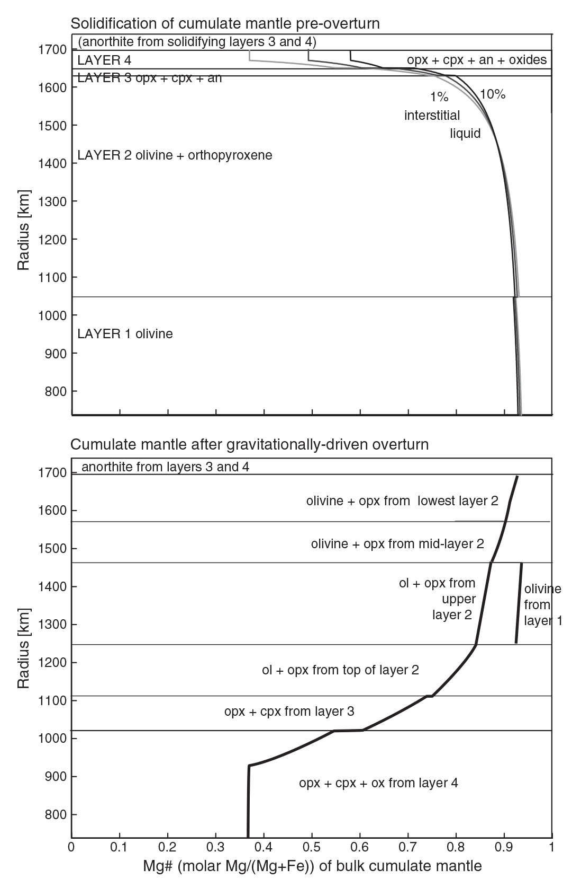
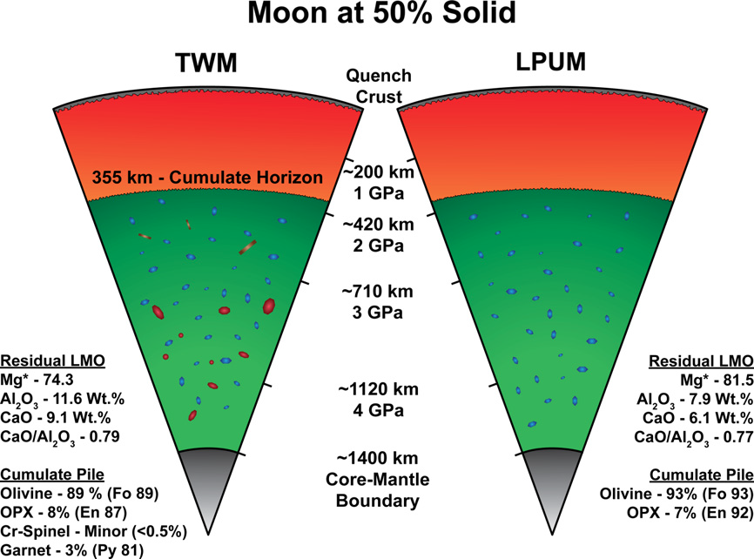
Lunar Magma Ocean
Elardo et al. (2011) GCA 75, 3024-3045.
Elkins-Tanton et al. (2011) EPSL 304, 326-336.

Slide 19
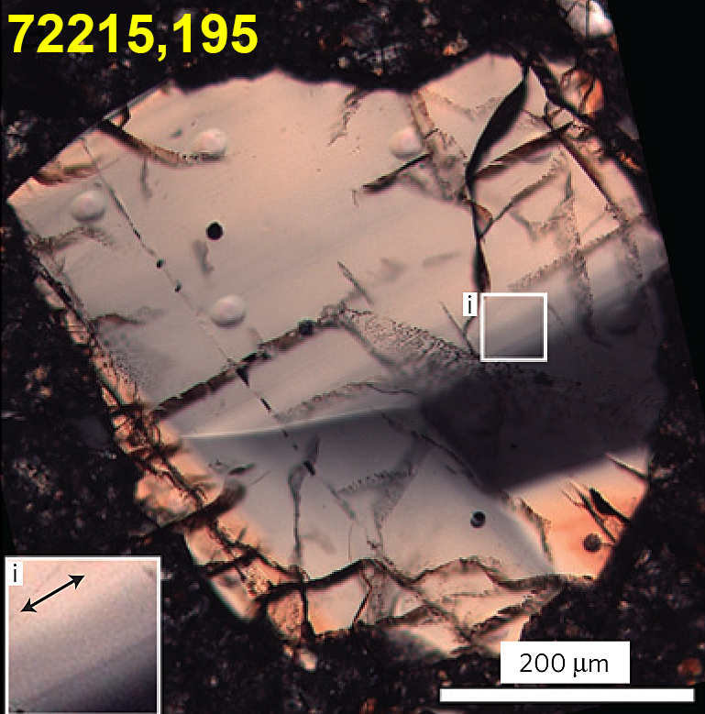
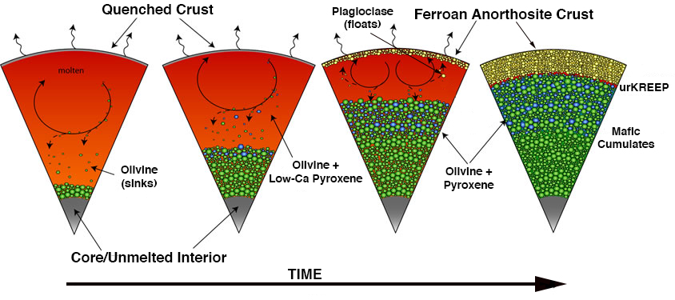
LMO Lifetime
Zircon Chronology
LMO solidification younger age limit = 4,417 ± 6 Ma;
Model: exponential crystallization rate between this age and Giant Impact age;
Crust formed after 80-85% LMO crystallization, ~100 m.y. after GI.
Complete cryst. after another 200-400 m.y.
Nemchin et al. (2009) Nat. Geosci. 2, 133-136.

Slide 20
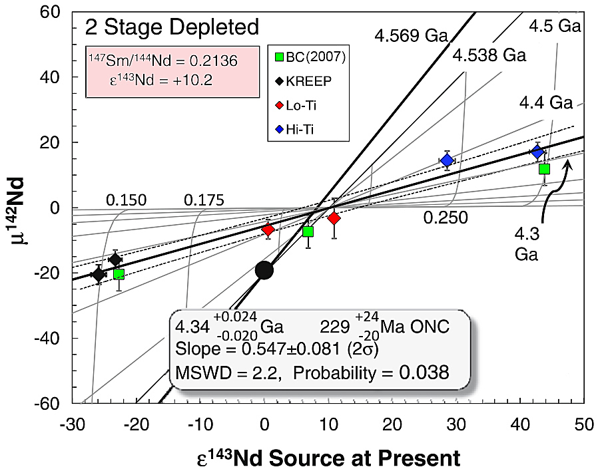
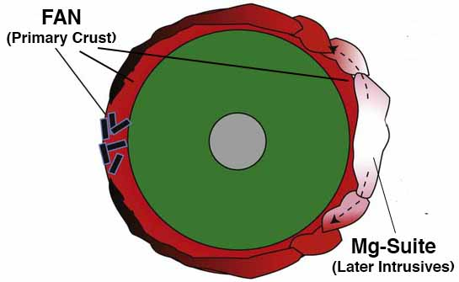
LMO Lifetime
229 Ma age (after onset of nebular condensation) means mare sources had a late Sm-Nd closure time.
Brandon et al. (2009) GCA 73, 6421-6445.
Boyet & Carlson (2007) EPSL 262, 505-516.
FANs are the only direct LMO products found in Apollo/Luna samples & Lunar Meteorites.

Slide 21
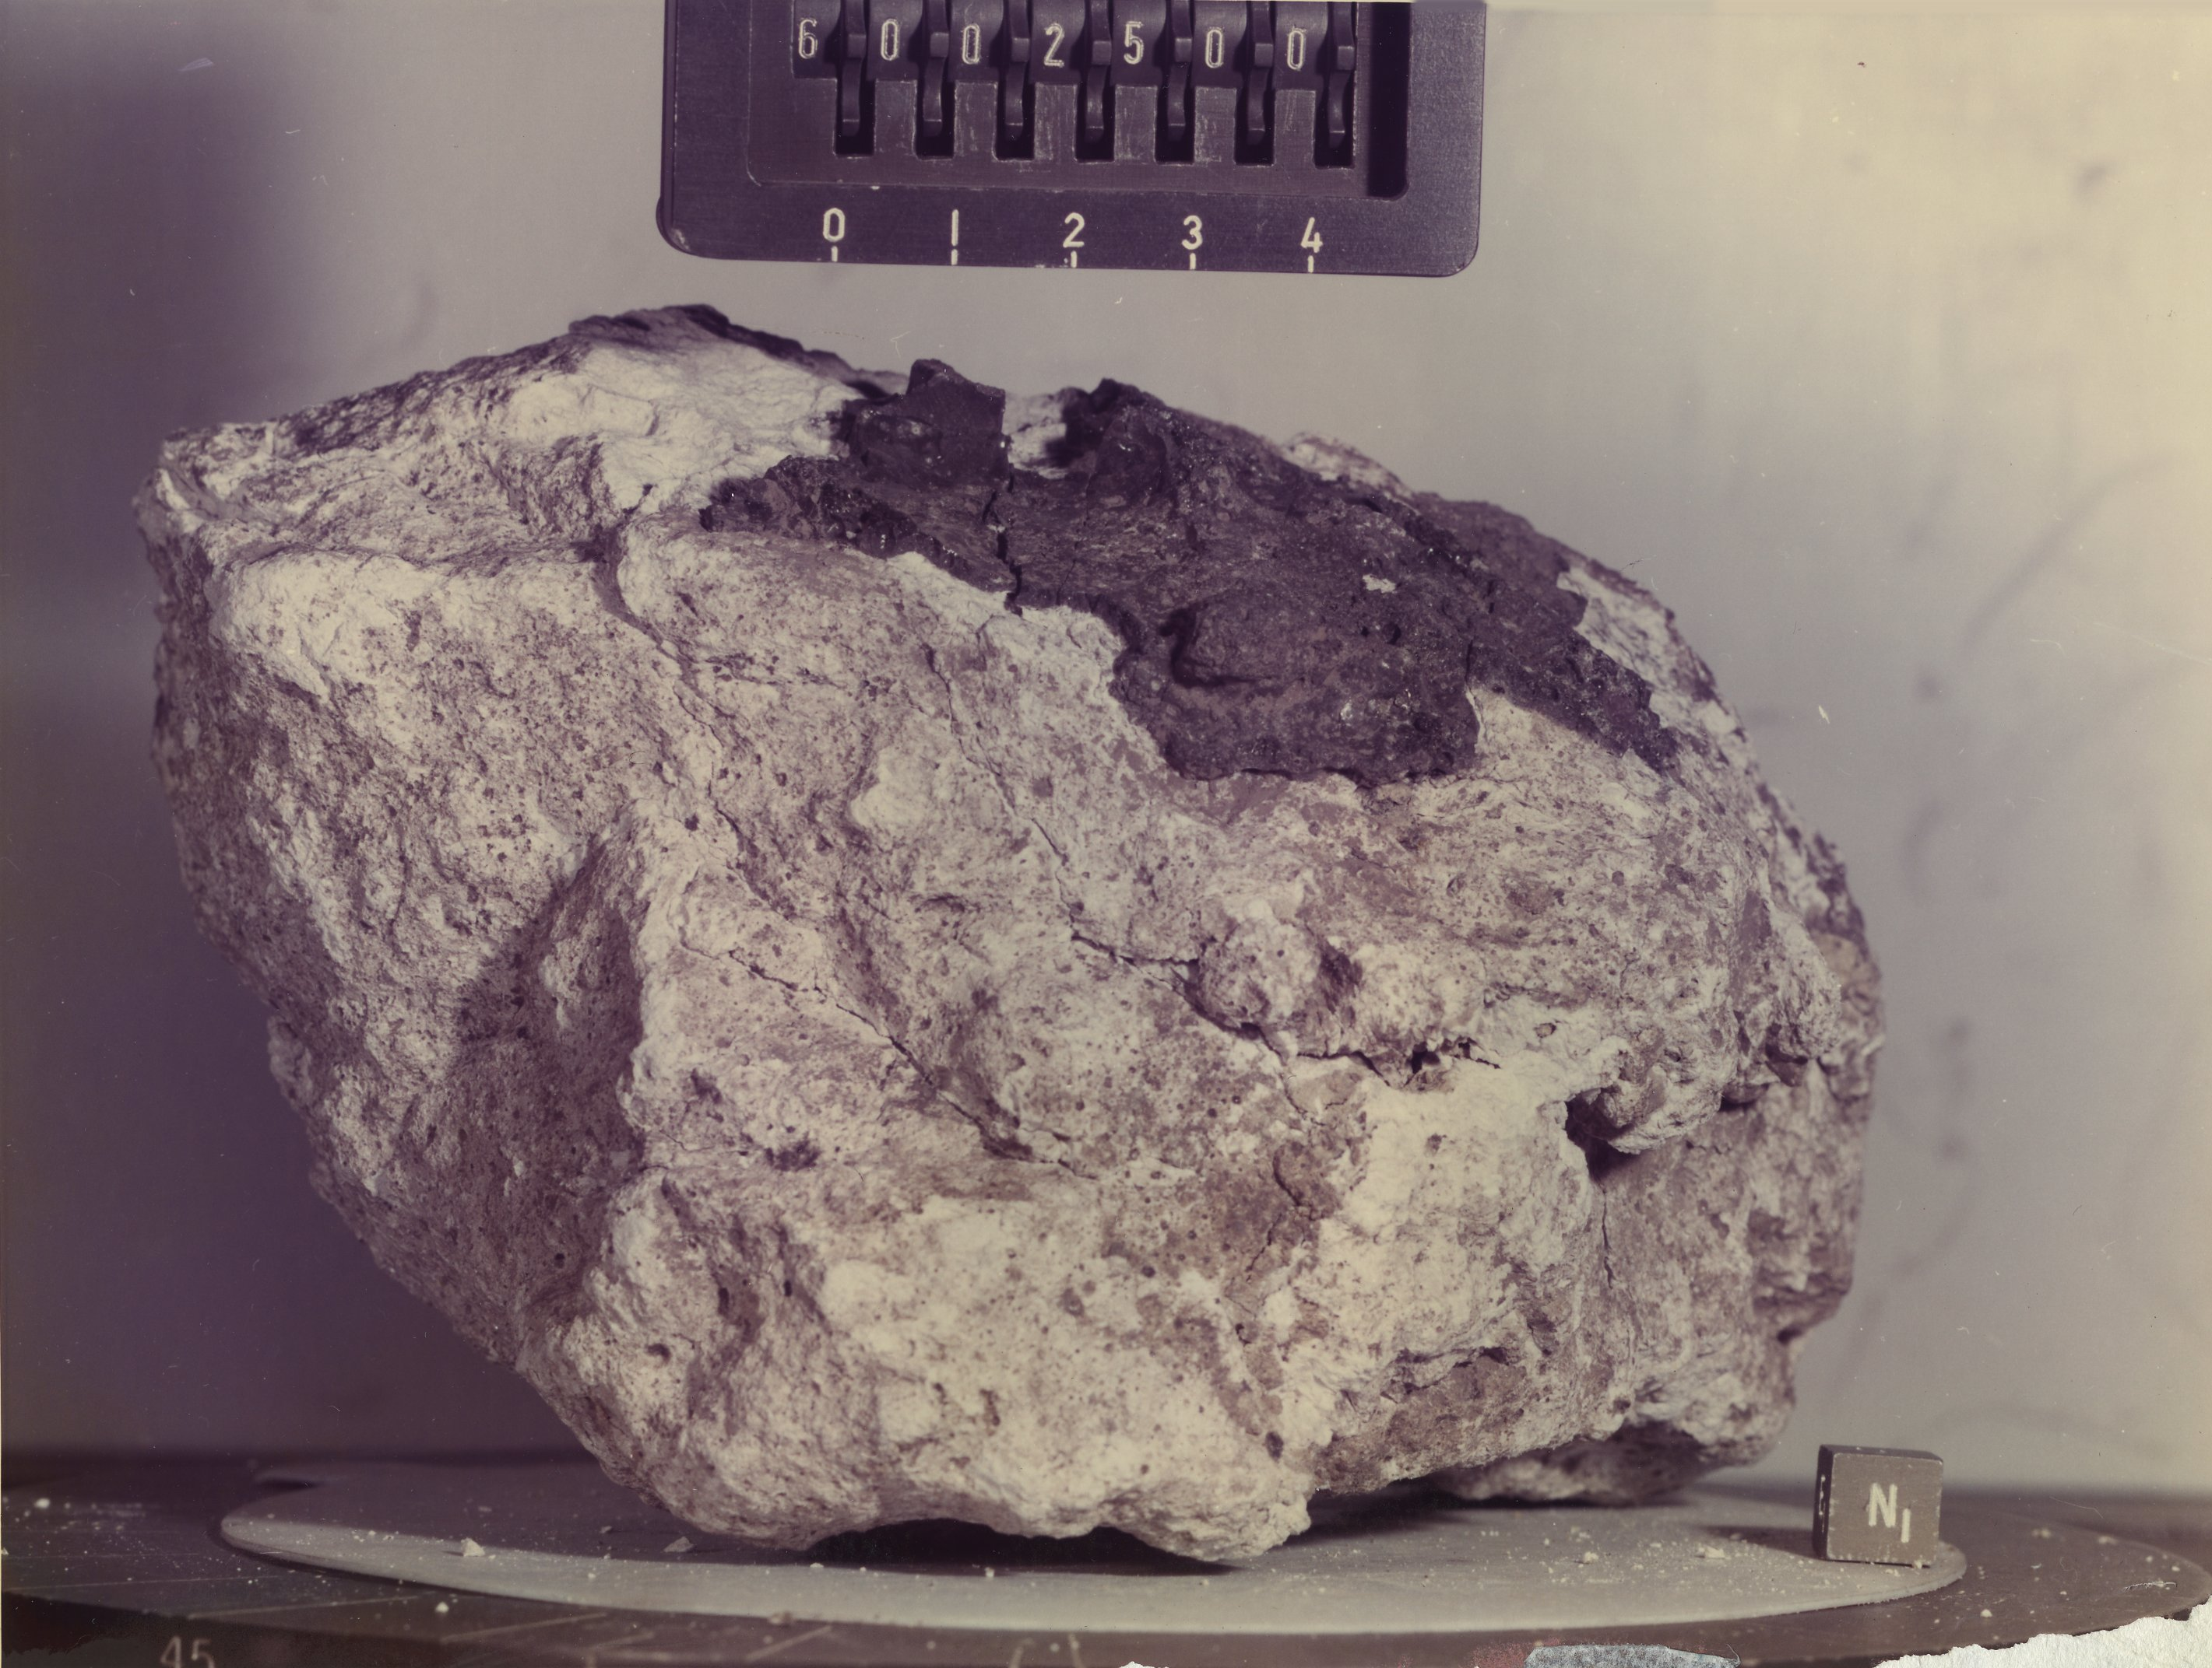
LMO Lifetime
FANs should be ~4.4 Ga.
60025
FAN 60025 = 4,360 ± 3 Ma
Young age requires long-lived LMO; Moon formed later than W-Hf data indicate;
FANs are not primary LMO products;
LMO did not occur.
Borg et al. (2011) Nature 477, 70-73.

Slide 22
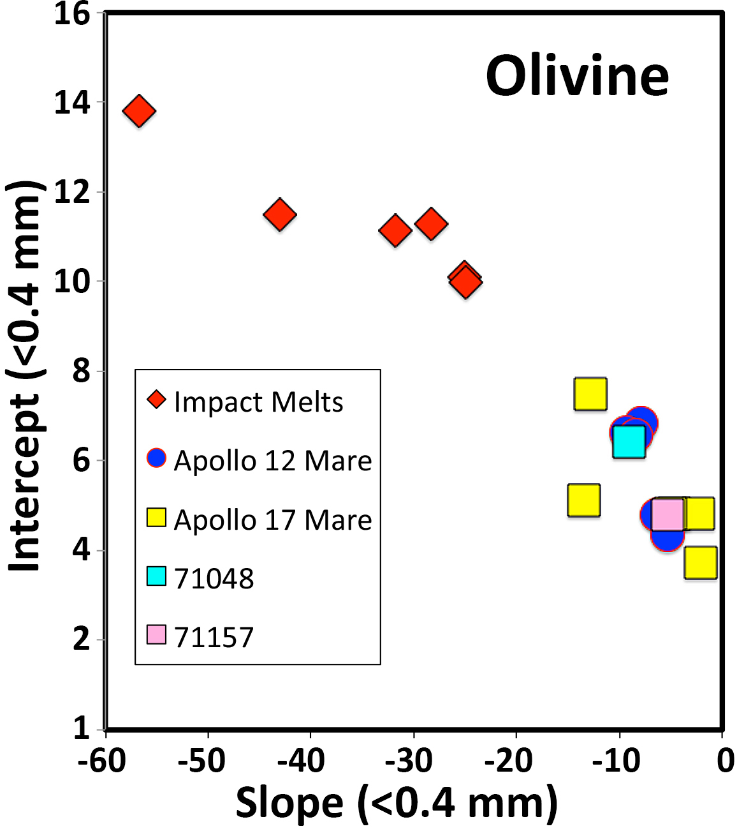
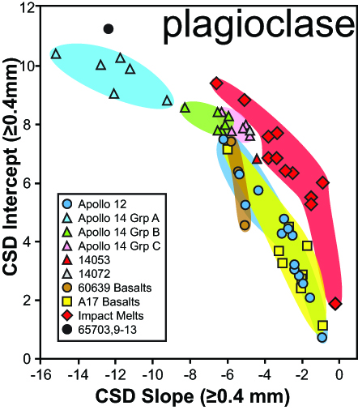
Non-Destructive Recognition
of Impact Melts
Textures used through quantitative petrography to distinguish impct melts from pristine basalts.
Crystal size distributions of olivine and plagioclase.
Method
Samples exhibit a variety of plagioclase CSD profiles. Focus on the steepest slopes (≤0.4 mm for olivine, ≥0.3 mm for plagioclase;) of CSDs.
Calculate slope within this range only using size bins that show increasing population density.
The intercept of the slope with the y-axis [ln(n^{O}) or nucleation density] was calculated using the same data.
Neal et al. (2013) MaPS (in prep.)
Roberts & Neal (2013) 44th LPSC, #2570;
Neal et al. (2011) 42nd LPSC, #2668.

Slide 23
Discovery of “Skylights”
Mare Inginii
Robinson et al. (2012) Planetary & Space Science 69, 18-27.
50 m
50 meters

Slide 24
LROC Images of Apollo-Era Landings
Surveyor 1
Surveyor 3
Surveyor 5
Surveyor 7
Surveyor 6

Slide 25
Rediscovery of Lunokhod 1 and Lunar Laser Ranging
March 2010
Murphy et al. (2011)
Icarus 211, 1103-1108

Slide 26
LROC @ Apollo Sites
Apollo 11
Apollo 17

Slide 27
GRAIL Mission Results
Data from the Gravity Recovery And Interior Laboratory (GRAIL) mission has produced the highest resolution gravity map of the Moon to date (spherical harmonic and degree 420).
Zuber et al. (2013) Science 339, 668-671.

Slide 28
GRAIL Mission Results
Bulk density of lunar highlands is lower than assumed (2550 kg m⁻³).
Average crustal thickness = 34-43 km.
Wieczorek et al. (2013) Science 339, 671-675.

Slide 29
GRAIL Mission Results
LGA-1 LGA-2 LGA-3 LGA-4
Bouger
Anomaly
Eötvös & Roche Craters
Crisium
Topography
(LOLA)
Identification of large dike intrusions (Linear Gravity Anomalies – LGAs).
Andrews-Hanna et al. (2013) Science 339, 675-678.

Slide 30
We have NOT “been there-done that”!!
Jolliff et al. (2000) JGR 105, 4197

Slide 31
We have NOT “been there-done that”!!
Apollo 11 at Washington National Monument

Slide 32
Future Moon Missions
COUNTRY NAME TYPE YEAR
China Chang’e 3 Lander 2013
USA LADEE Orbiter 2013
Private GLXP Landers 2014
China Chang’e 4 Lander 2015
India Chandrayaan-2 Lander 2015
Russia Luna 25 Lander 2015
Russia Luna 26 Orbiter 2016
Russia/India Luna 27 Lander/Rover 2017
USA Resource Prospector Lander/Rover 2018
Russia Luna 28 Cryo SR 2019
Russia Lunokhod 3 Rover 2020?
Japan SELENE-2 Lander 2018
China Chang’e 5 Lander 2017
South Korea Moon Orbiter Orbiter 2020
South Korea Moon Lander Lander 2025
Notes:
Animated: 1) Clementine Fe, Ti maps; 2) LP K and Th maps; 3) Use the Clem + LP to get terrane maps.

